Slide 1
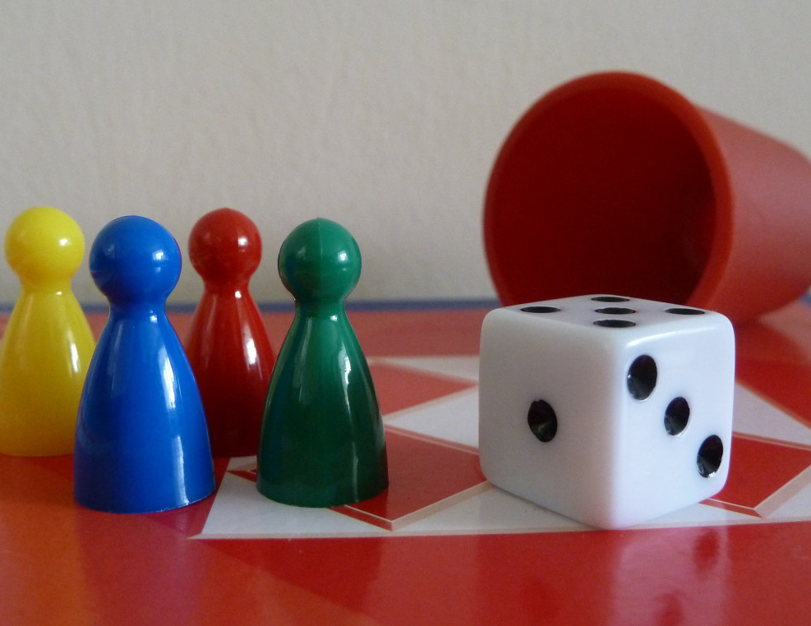
Software Project Lab-1
Dynamic Ludo Game

Slide 2
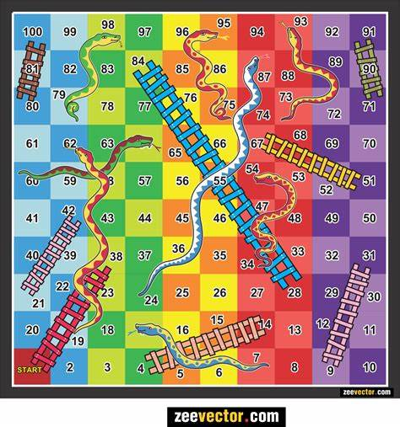
Presented by
Kazi Shamil Akram
Roll: 1518
For SE-2105
Supervised by
Dr. Md. Mahbubul Alam Joarder
Professor, IIT, DU

Slide 3
Project Overview
This program plays a ludo game in a different way.
A ludo has two versions- the normal one with a cross-shaped board containing a series of nodes. This version instead asks to traverse a maze, each player taking the number of step gotten from the dice, with the first player to escape his own maze winning.
The second version is snake-and-ladder, which in this version is played with dynamica snake and ladder positions. The placement of the snakes' heads and tails, the ladders' top and bottom, all changing randomly, thus providing more challenge and unpredictabilty.

Slide 4
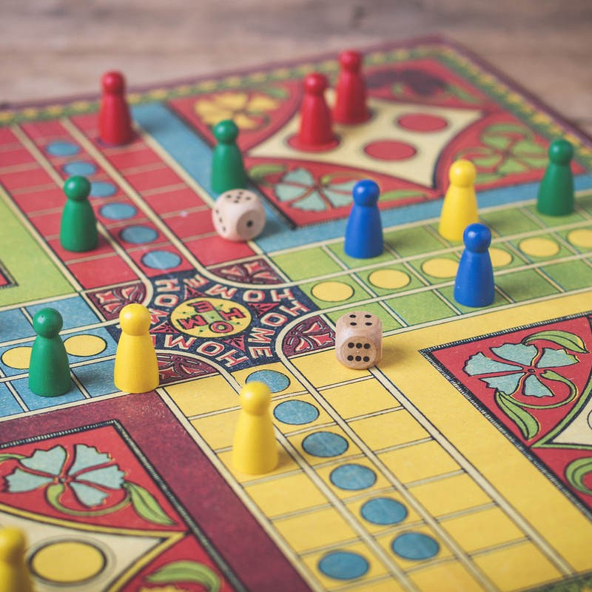
What do I gotta do...
Two different parts of the game, understandably to be approached differently.
The snake version's to be made by taking a pair of variables and assigning to them random numbers- they denote the snake's head and tail, or the ladder's top and bottom.
The other version- has been written with a maze accessed into a matrix (2D array), which then will have its path accessed as a (1D) array, and the dice's number represents how many nodes can the player traverse at each step.
Oh, and the dice itself is taken as another random integer between 1 and 6.

Slide 5
Let's take a closer look, shall we?
The path here is:
matrix [0][2] -> [1][2] -> [1][1] -> [2][1] -> [3][1] -> [3][2] -> [4][2]
Suppose the dice roles 2. Now, the player has to go from [0][2] to [1][1]. Next dice roles 3, meaning [1][1] -> [3][2]
# | # | 0 | # | #
# | 0 | 0 | # | #
# | 0 | # | # | 0
# | 0 | 0 | 0 | #
# | # | 0 | # | #

Slide 6


Meanwhile with snake:
Can suddenly have its ladder go
from 7-19 to either a snake from 7-4, or a ladder from 3-10, or even something entirely different.
21 | 22 | 23 | 24 | 25
20 | 19 | 18 | 17 | 16
11 | 12 | 13 | 14 | 15
10 | 9 | 8 | 7 | 6
1 | 2 | 3 | 4 | 5

Slide 7
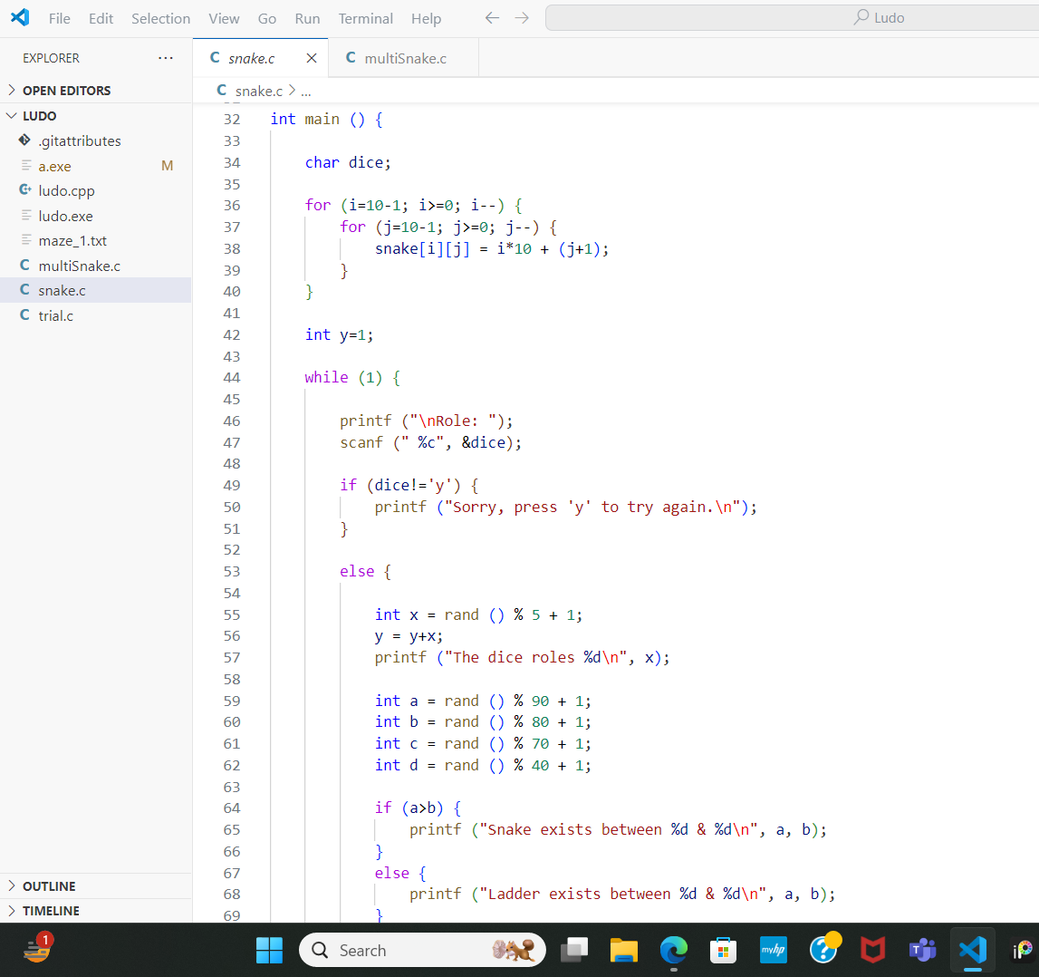
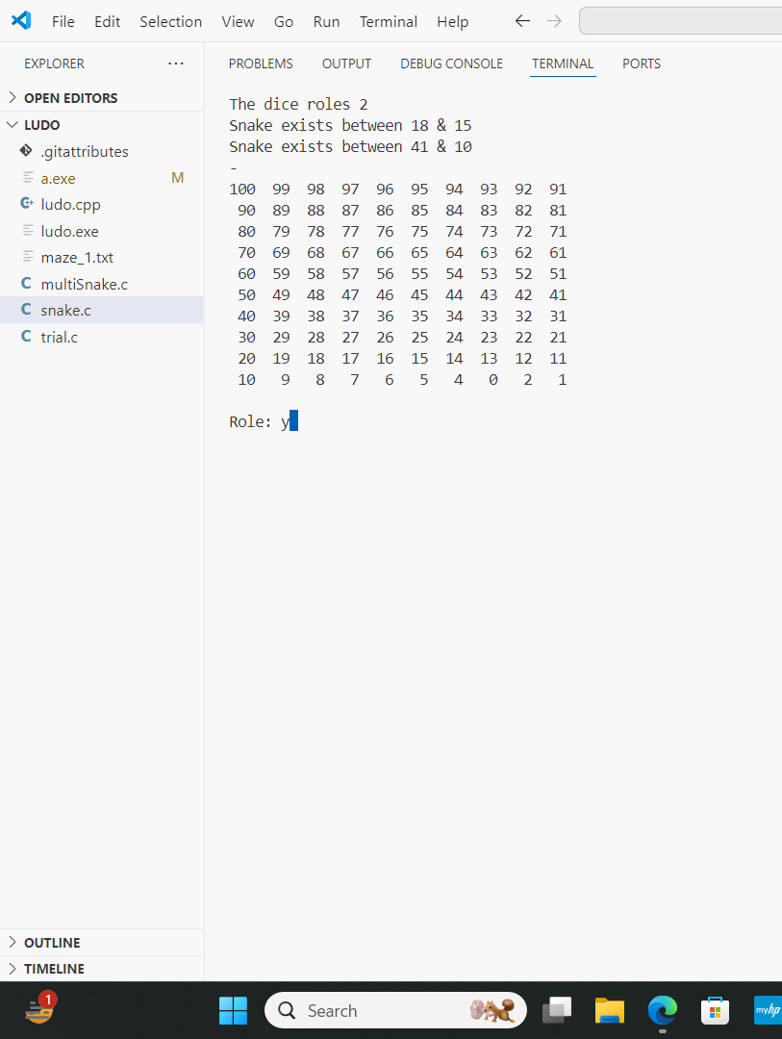
The program The output

Slide 8
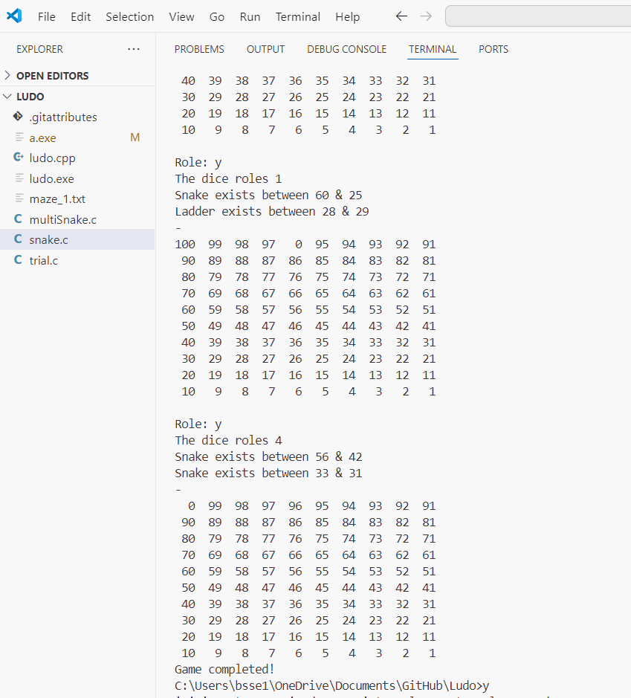
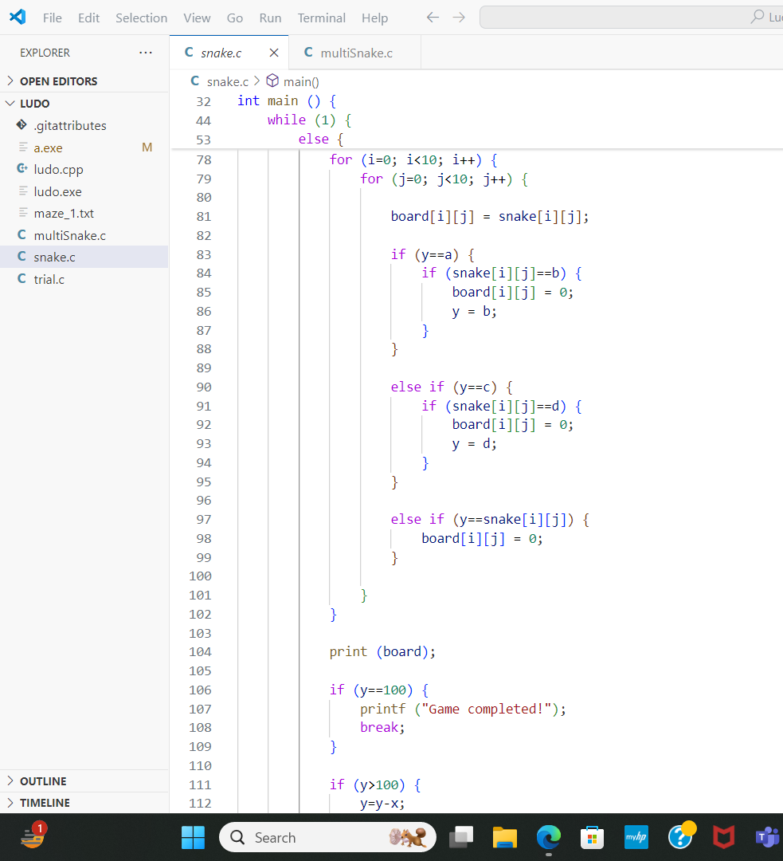

This is the part that runs the game:

Slide 9
Challenges
Can have some subtle bugs that'll run the loop unwanted number of times.
Make sure to stop the game as soon as one player wins.
Keep counts of the numbers, random numbers and dice properly.
For the maze version:
Accessing the maze as a 2D matrix from a text file, and then again the path inside the matrix to a 1D array.
The pathfinding itself.
The next step of this game, backtracking, will be the most difficult.

Slide 10
Upgrades for future:
Completing the maze version and adding options to choose multiple ways and backtrack, with the added limitation of fixed "lifetimes" that'll incrementally decrease per each mistaken backtrack.
Giving players the option to choose single-player and multiplayer mode, for both snake and maze version.
How is it special?
This program runs a game that'll allow players to choose different options, a different experience of playing in terminal without graphics, and add challenges with unpredictable obstacles.

Slide 11
Tools:
Visual Studios, C and C++, GitHub.
(No graphics was used to make this game.)
Referrences:
https://stackoverflow.com/questions/63757044/while-loop-is-running-twice-in-c
https://www.naukri.com/code360/library/random-function-in-c
https://www.geeksforgeeks.org/c-program-to-read-contents-of-whole-file/

Slide 12
Thank you

